Slide 1


Ahsanullah University of Science and Technology
Encoder Digital Circuit Design.
Group Members:
ID: 190205083
ID: 190205089
ID: 190205093
ID: 190205096
ID: 190205101

Slide 2

Introduction
Digital encoders are essential components in digital circuitry, used to convert input data from one format to another. They play a crucial role in various applications, including data communication, memory addressing, and signal processing. In this discussion, we will explore four different types of digital encoders and their designs:

Slide 3

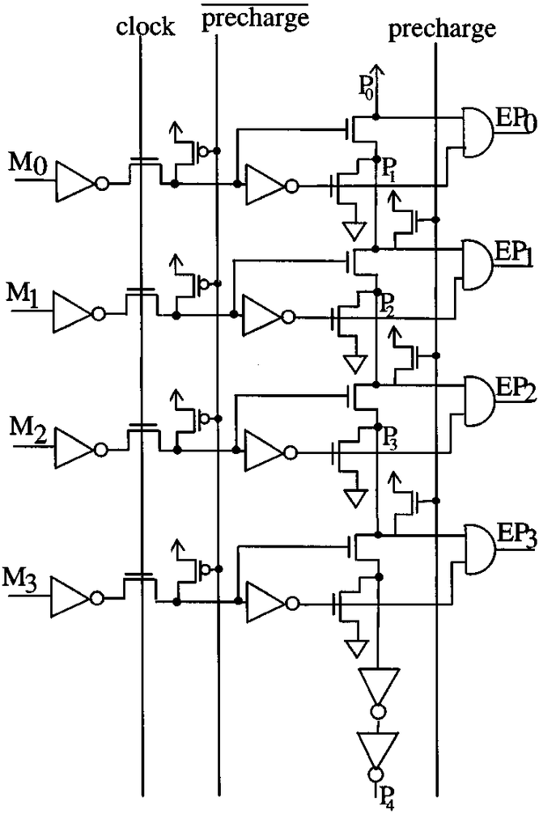
4-Bit Priority Encoder:
A 4-bit priority encoder is a fundamental digital circuit that prioritizes multiple input lines and encodes them into a binary code. Priority encoders are commonly used in microprocessors and memory systems to handle interrupt requests and address prioritization. The encoder assigns a unique binary code to the highest-priority active input line, allowing the processor to identify and process the most critical task.

Slide 4

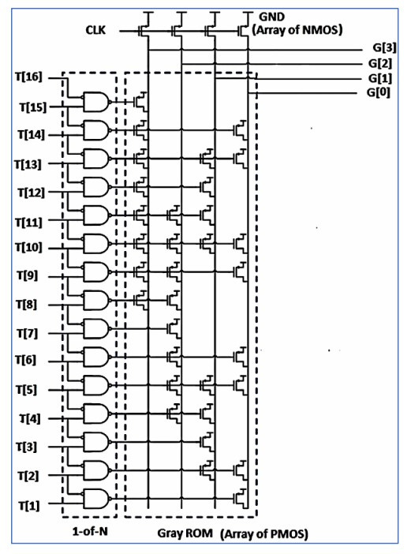
4-Bit Gray ROM-based Thermometer to Gray Encoder:
Gray code is a binary numeral system where two consecutive values differ in only one bit. This property is valuable in various applications, such as rotary encoders and position sensors. A ROM (Read-Only Memory) based thermometer to Gray encoder is designed to convert a thermometer code, where only one bit is high at a time, into a Gray code representation. This conversion is useful in applications requiring precise position sensing and control.

Slide 5

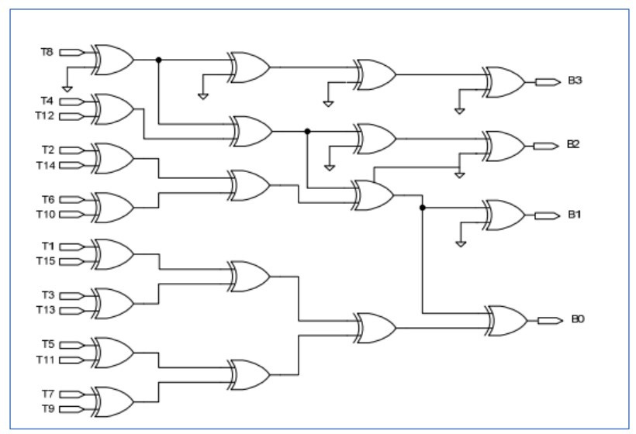
Encoder Implemented in XOR Gates:
XOR (Exclusive OR) gates are fundamental logic gates that perform binary addition without carry. An encoder implemented using XOR gates takes multiple input lines and encodes them into a binary output. XOR-based encoders are efficient and widely used in various applications, including data compression, error detection, and signal multiplexing. They provide a straightforward way to convert input data into a binary format.

Slide 6

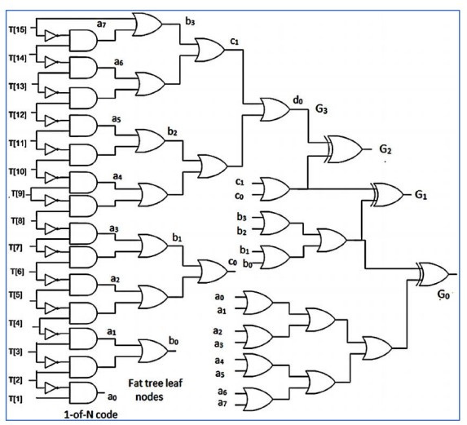
Conventional Fat Tree Encoder:
A conventional fat tree encoder is a specialized type of encoder used in networking and routing systems. Fat trees are hierarchical network topologies that are highly fault-tolerant and scalable. In this context, a fat tree encoder is responsible for mapping network addresses or requests to appropriate paths within the network. These encoders are critical for load balancing and efficient data routing in large-scale data centers and high-performance computing environments.

Slide 7

4-Bit Priority Encoder:

Slide 8
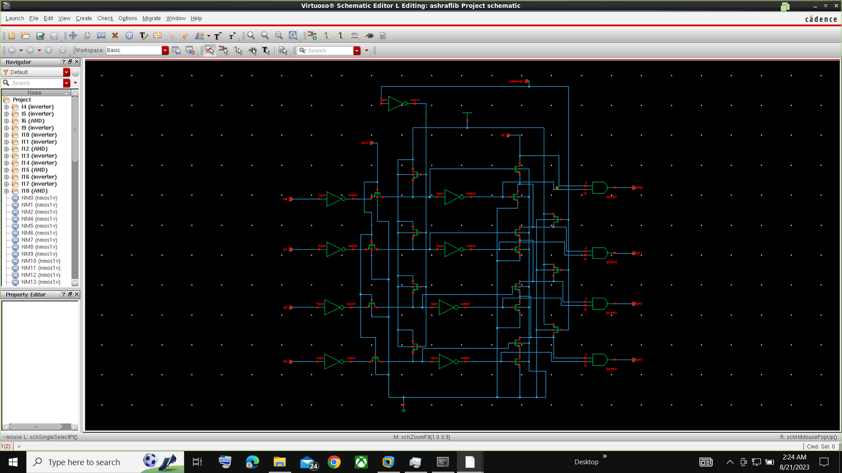
4-bit priority encode

Slide 9
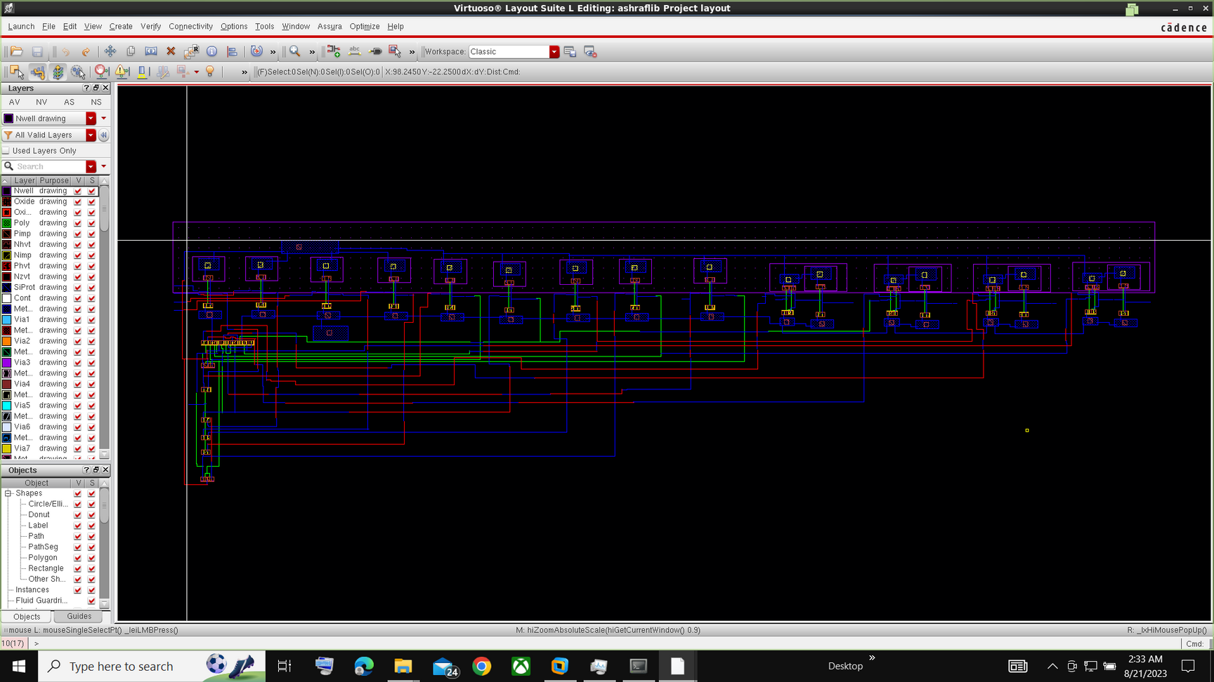
Layout:

Slide 10
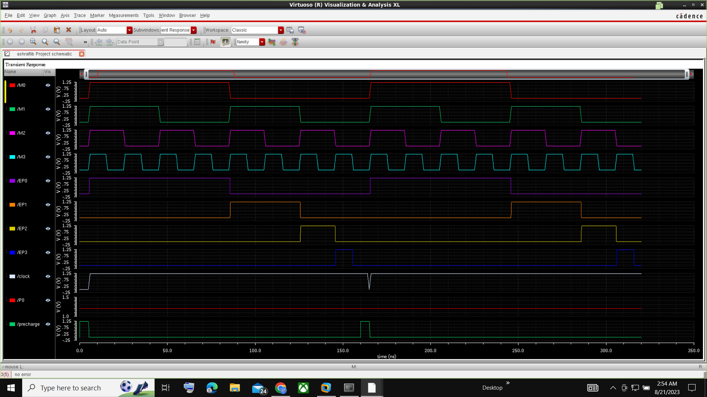
Output:

Slide 11
4-bit Gray ROM based Thermometer to Gray encoder

Slide 12
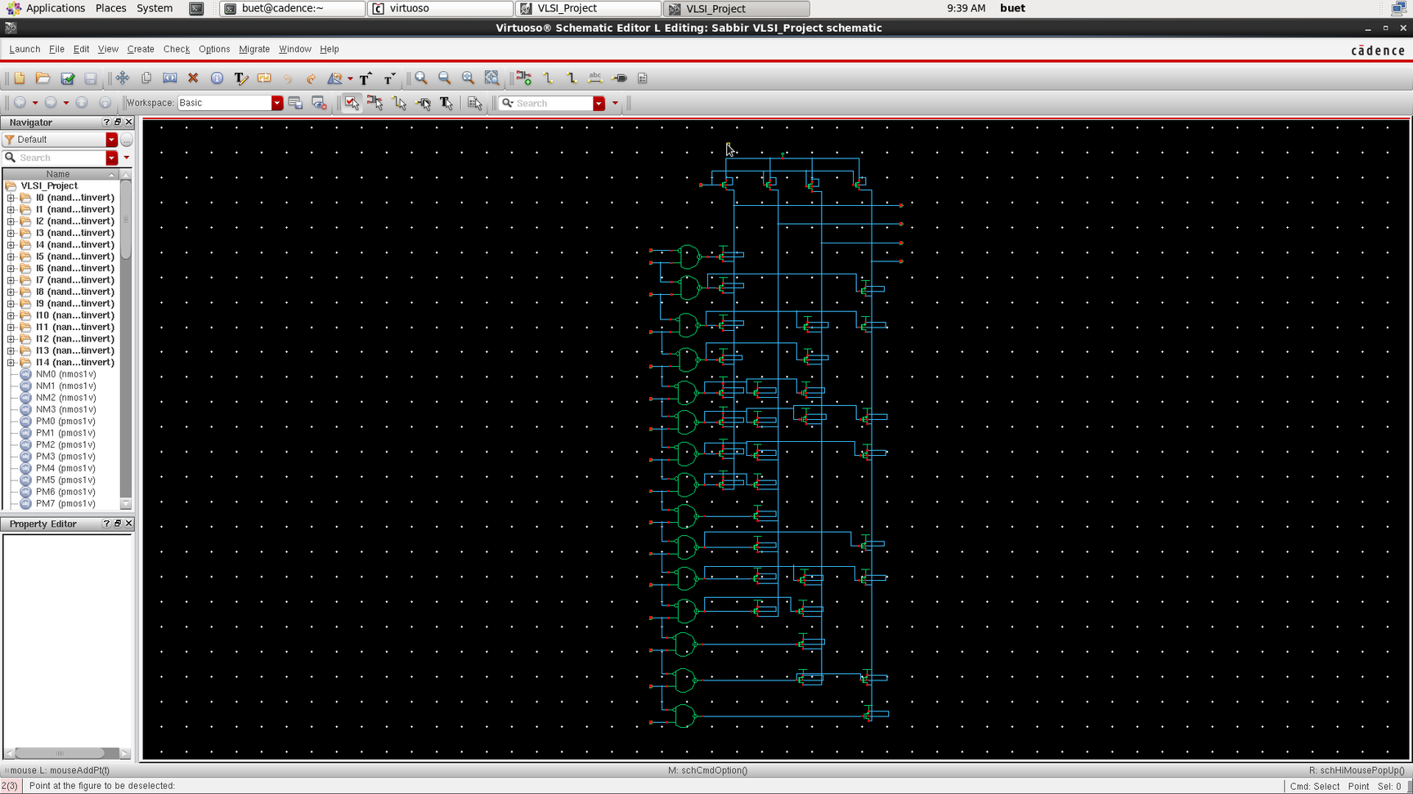
4-bit Gray ROM based Thermometer to Gray encoder

Slide 13
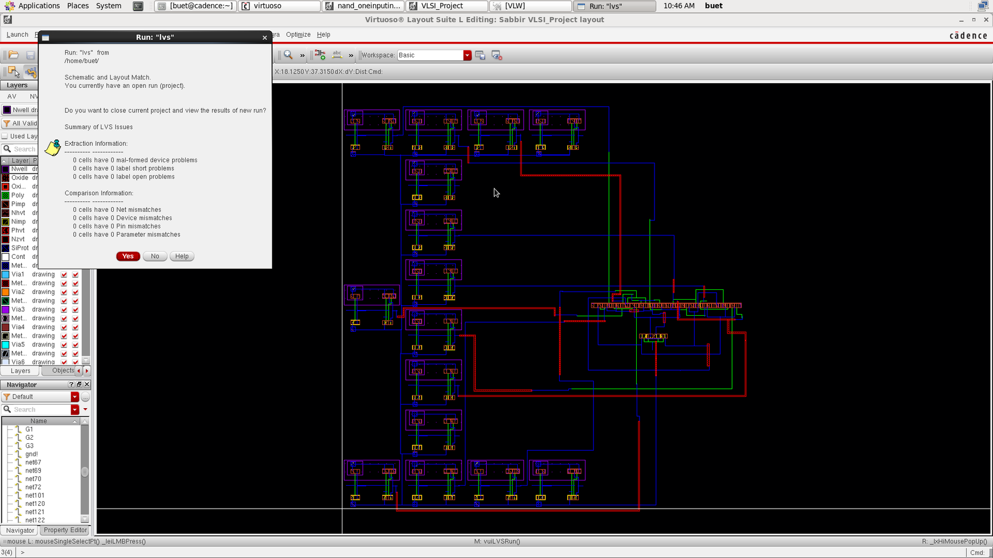
Layout:

Slide 14
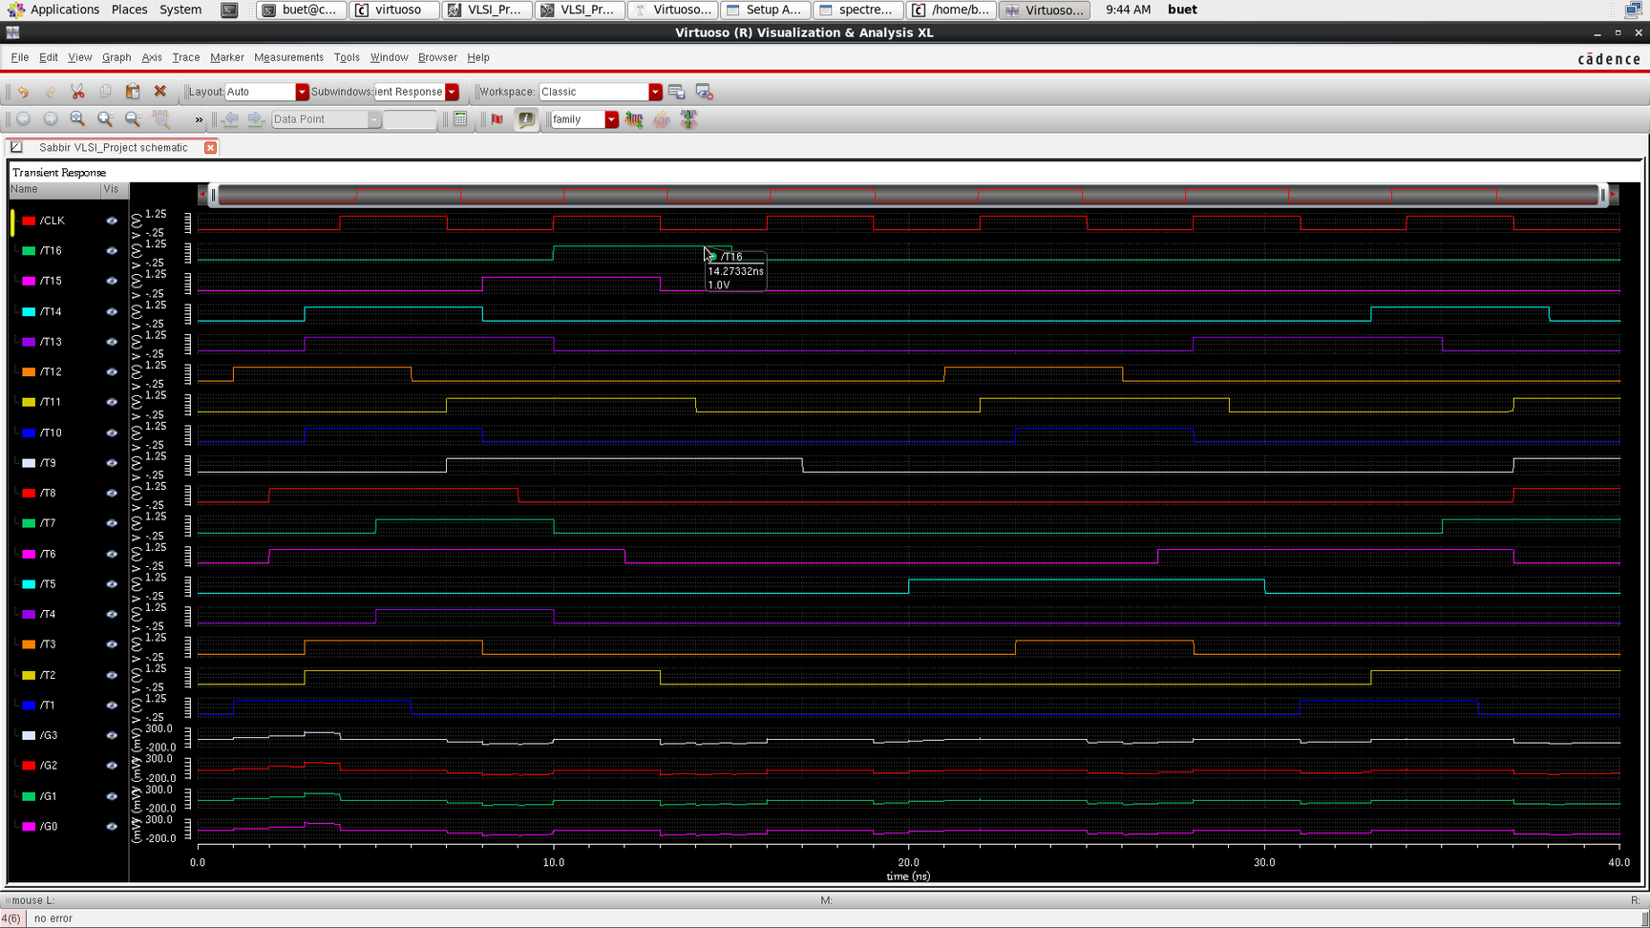
Output:

Slide 15
The encoder implemented in XOR gates

Slide 16
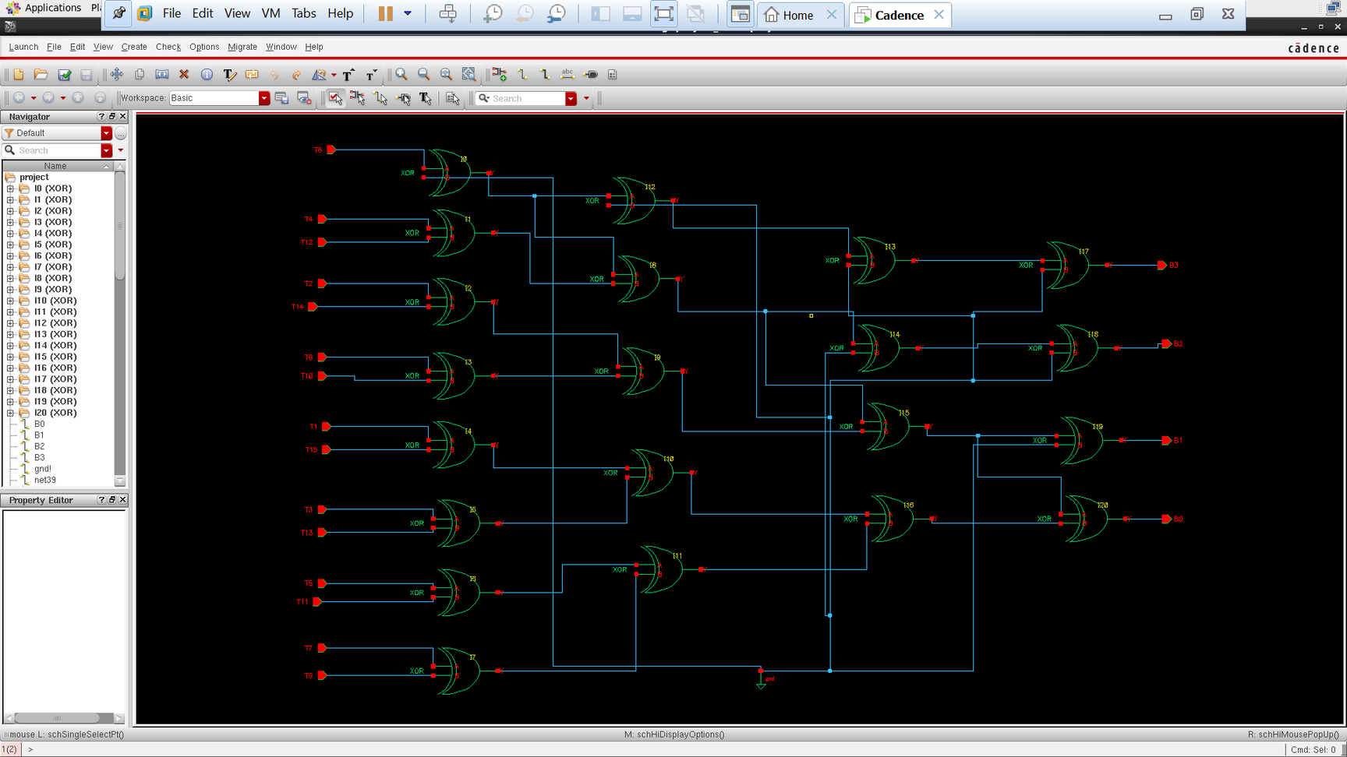
The encoder implemented in XOR gates

Slide 17
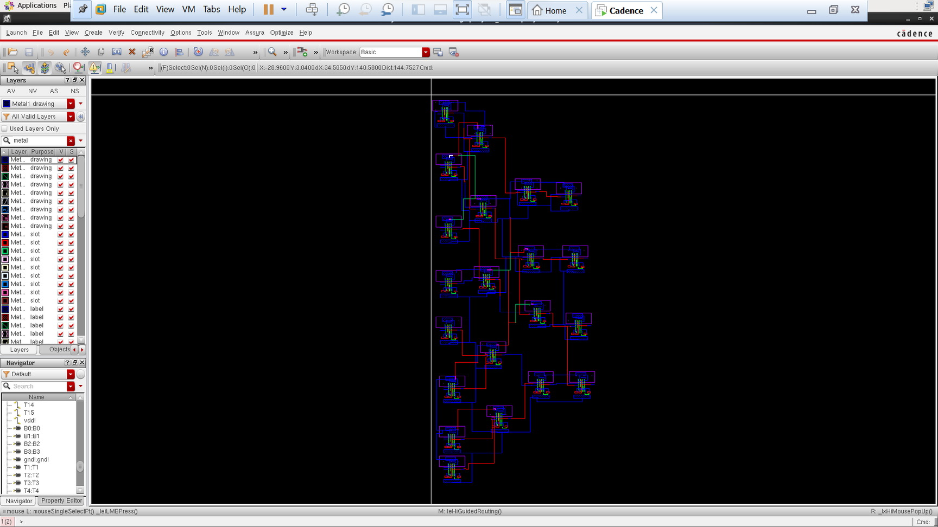
Layout:

Slide 18
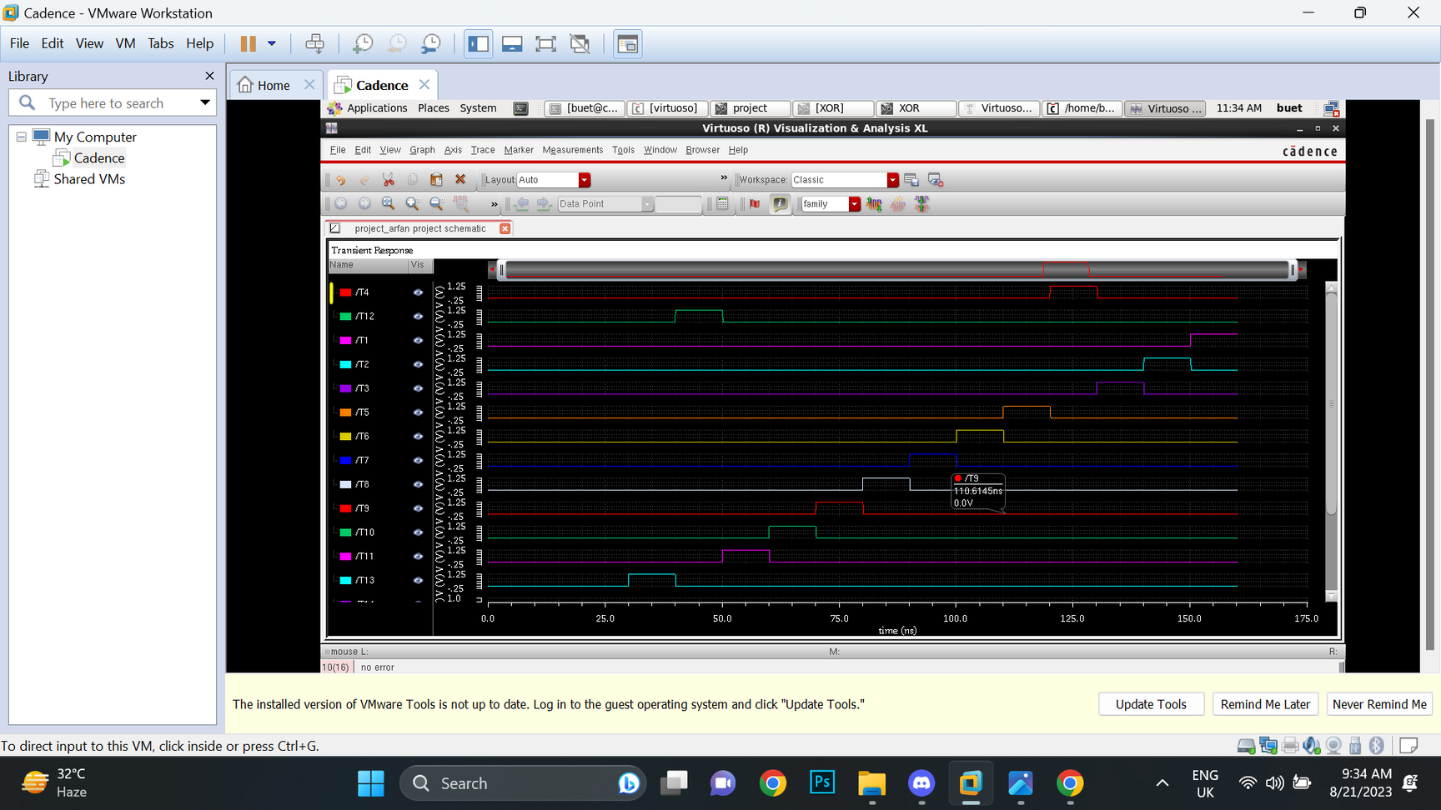
Output:

Slide 19
Conventional Fat tree encode

Slide 20
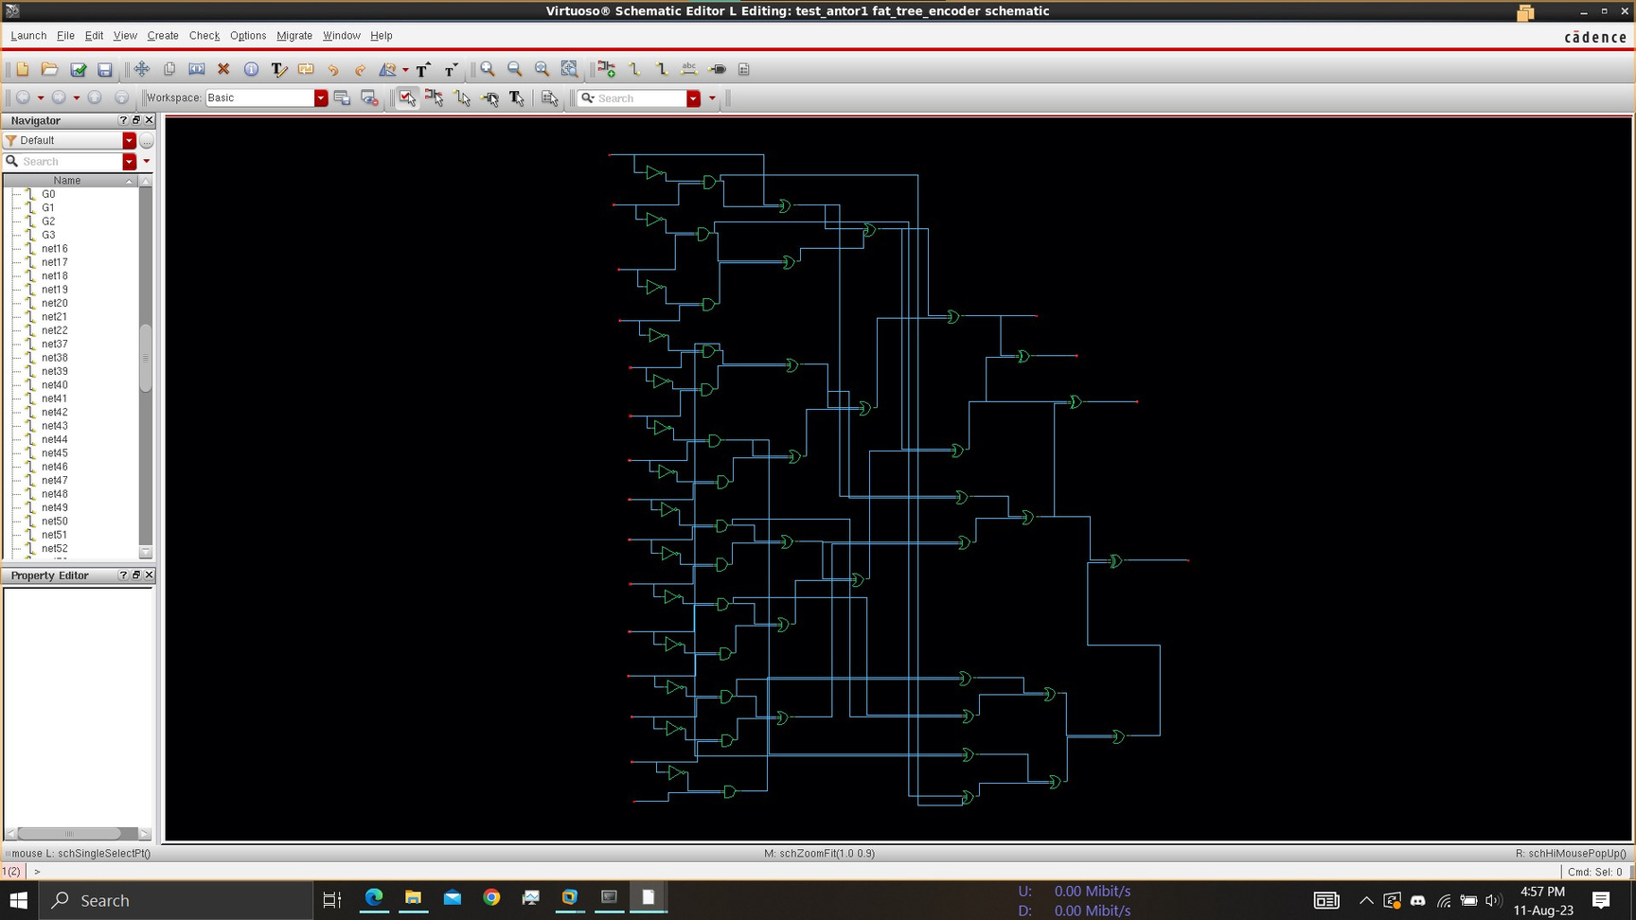
Conventional Fat tree encode

Slide 21
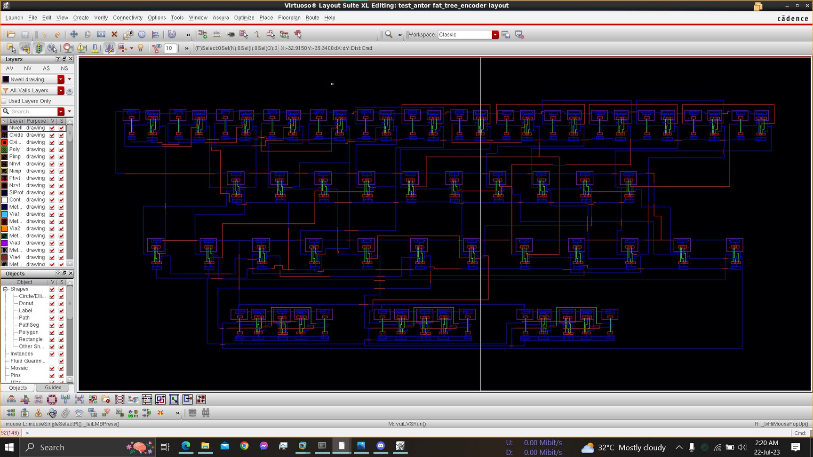
Layout:

Slide 22
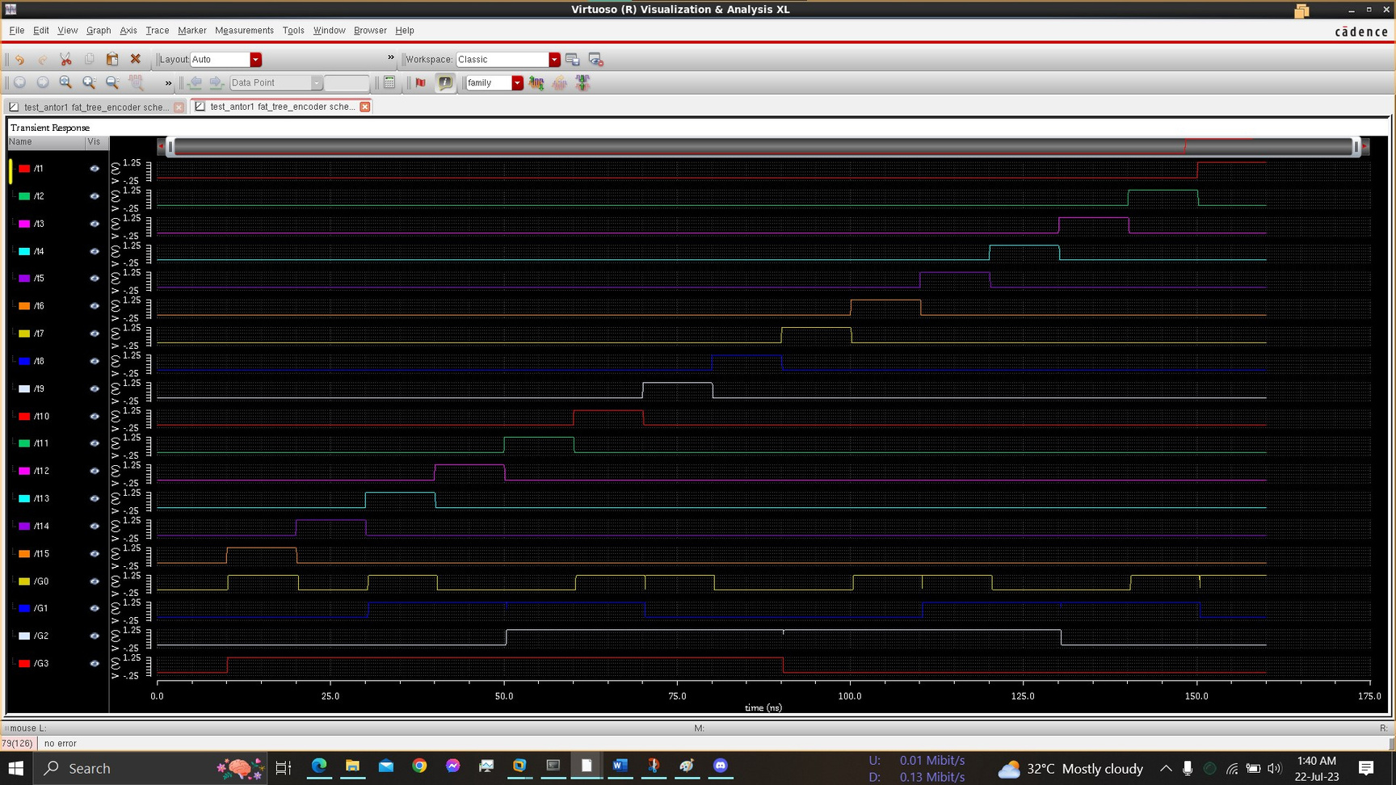
Output:

Slide 23
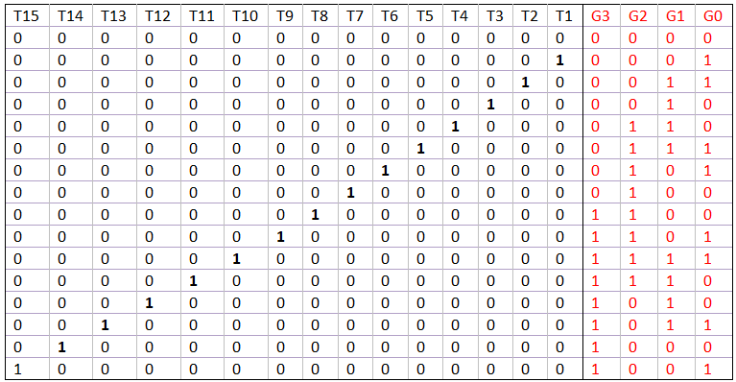
Truth Table:

Slide 24



THANK YOU

